Slide 1
CSCI 8360: Data Science Practicum
Lecture 1
Prof. Shannon Quinn

Slide 2
Part I: Lightning Overview
CSCI 8360 Data Science Practicum

Slide 3
Data Science
What is it?
Why is it important?
How does one learn it?

Slide 4
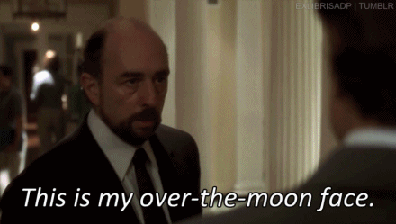
CSCI 8360: What Is It?
What this class IS:
Hands-on data science
Team-based problem solving
“Kaggle in the Classroom”

Slide 5
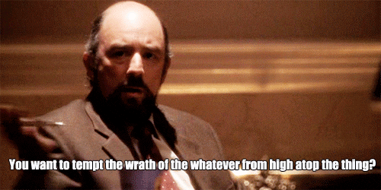
CSCI 8360: What Is It?
What this class IS NOT:
Introduction to Machine Learning
Introduction to Distributed Systems
Introduction to Software Engineering

Slide 6
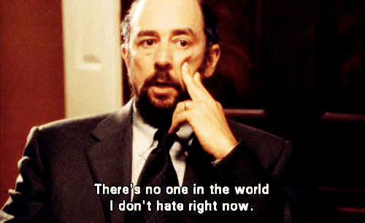
CSCI 8360 Requirements
Thorough understanding of machine learning and statistics
(or teammates who can bring you up to speed very quickly)
Good software engineering skills
(working on teams)
An ability to learn fast
(definition of “graduate student”)

Slide 7
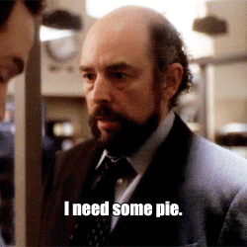
CSCI 8360 Links
Course website
https://dsp-uga.github.io/sp21
Lectures and assignments will be posted here
Discord
This is where all course communication will happen
(yes, we used Slack in previous years; testing this out this semester)
GitHub
https://github.com/dsp-uga/
All team development will happen here
AutoLab
https://autolab.cs.uga.edu
Project submissions for grading and evaluation
Google Compute Platform (GCP)
Everyone will get credits

Slide 8
Course Outline
3.5 Projects (+ a pseudo-project), each 3(+) weeks
Lecture every Wednesday (except the first two weeks)
Office hours Tuesday/Thursday (except the first two weeks)
No exams!
No final project!
No grades!
Attendance

Slide 9
Part II: Administrative Details
CSCI 8360 Data Science Practicum

Slide 10
Lectures, Revisited
Locations:
In-person: Boyd 208 (Wednesdays); Food Science 202 (Tues/Thurs)
Virtually: Discord Server
Time
Today, 11:30am – 12:20pm
Tomorrow, 11:10am – 12:25pm
Next Tuesday (Jan 19), Wednesday (Jan 20), and Thursday (Jan 21)
NO OTHER LECTURE TIMES (unless announced in Discord)
Policy
Attend, don’t attend, up to you (except for guest lecturers—please come for those)
Lectures will be recorded and posted on the website

Slide 11
Office Hours, Revisited
Location: Food Science 202 (and Discord server)
Time: Tuesdays / Thursdays, 11:10am – 12:25pm
(yep, when we’d otherwise have lecture, so I know you can’t possibly have conflicts)
Happy to set up appointments if you need them

Slide 12
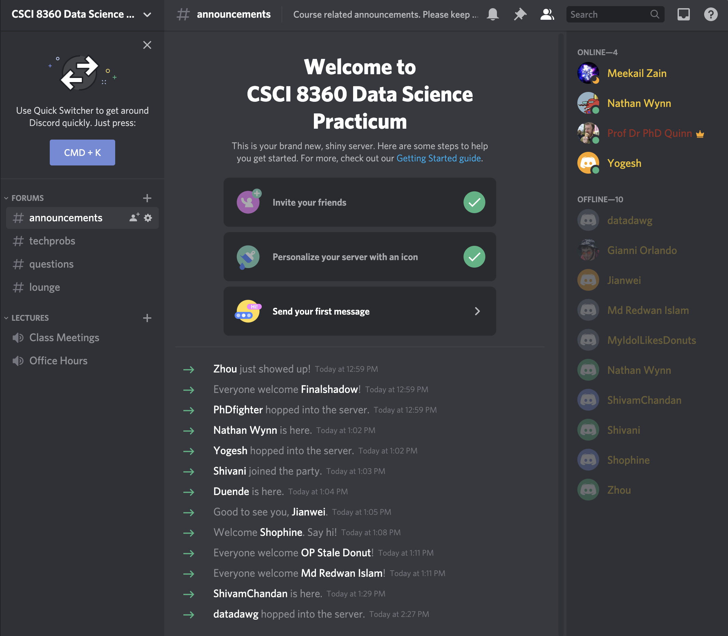
Discord, Revisited
Discord: free team messaging platform
Web-based and mobile apps
Teams can set up private channels to coordinate
Can also send individual DMs
All course announcements will be made here

Slide 13
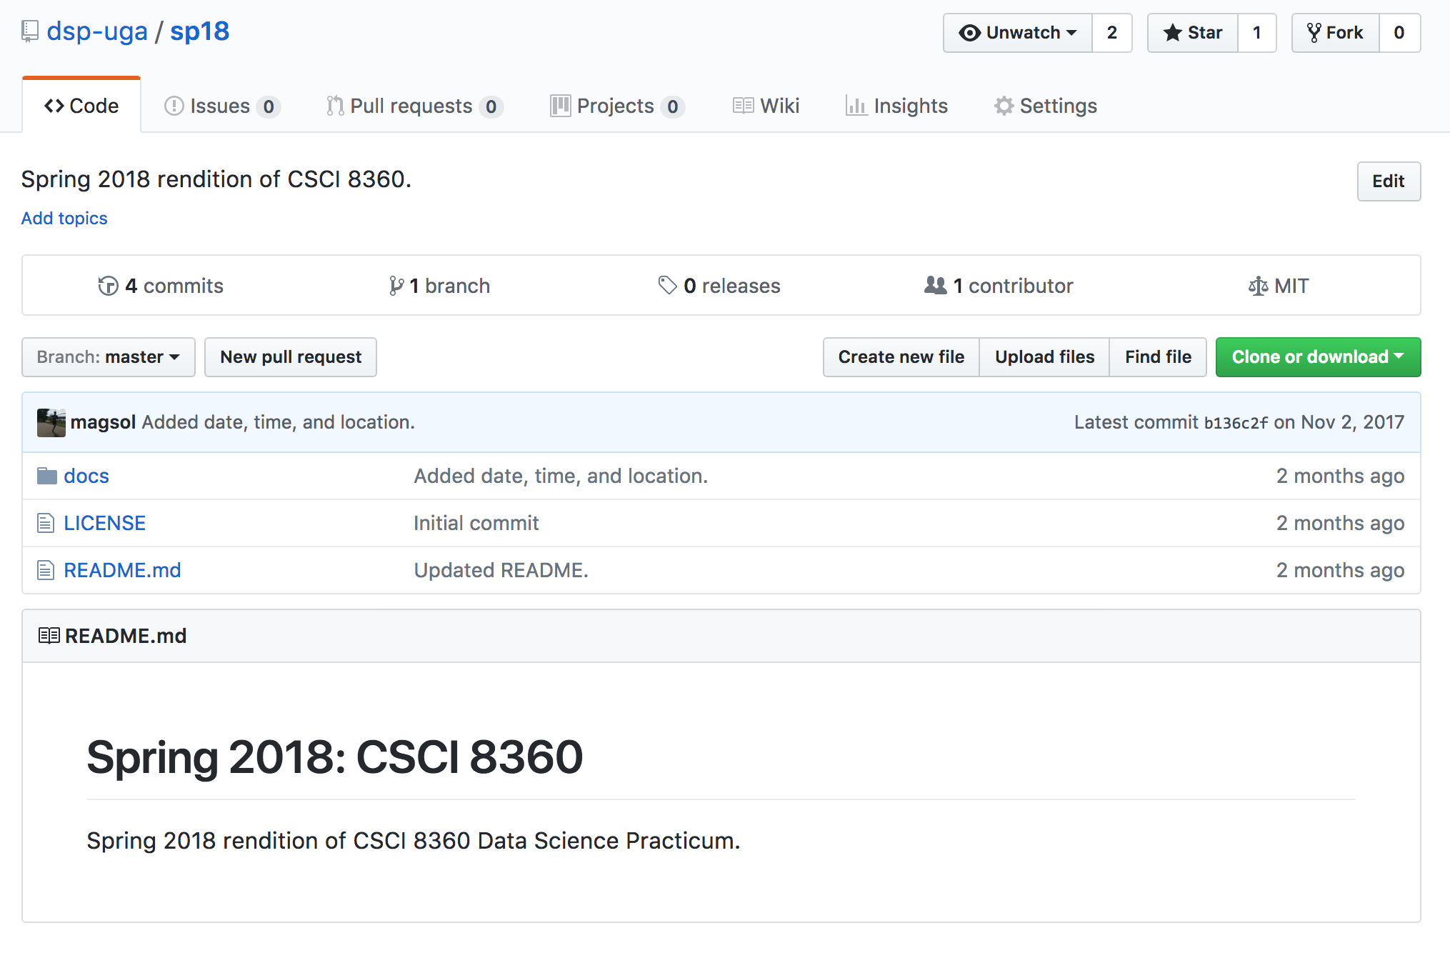
GitHub, Revisited
Most popular code repository in the world
Uses the git concurrent versioning system (itself an open source project)
Lots of useful team-based tools (issue tracker, wiki, GUI)
All projects will be sourced in the DSP-UGA GitHub organization

Slide 14
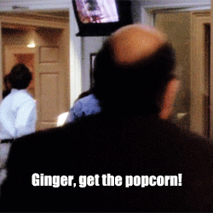
AutoLab, Revisited
Assignment submission and autograder
Also has leaderboards!
All project outputs will be submitted to AutoLab for ranking

Slide 15
Google Cloud Platform
(comparable to Amazon Web Services, or AWS)
Spin up elastic compute resources on-demand
Every student gets $50 in credits (usable across ALL services)
“Cloud Dataproc” contains APIs for specifically spinning up Spark and Hadoop clusters
Details to come

Slide 16
Part III: Projects
CSCI 8360 Data Science Practicum

Slide 17
Project Overview
Solving real-world machine learning problem
Classify a large corpus of documents
Convex optimization over a huge dataset
Dimensionality reduction over a high-dimensional matrix
etc.
Each project varies in length from 3 to 4 weeks
“Introductory” Project 0 out tomorrow, will be 1.5 weeks long
Project 1 (P1) out the following Tuesday (Jan 26), will be 3 weeks long

Slide 18
Project Requirements: Teams
Teams (3-4 people per team)
Assigned completely randomly (by me)
Will change for each project
Each team member should have a clear, well-defined role
Not everyone has to be a coder!
But 1 person should not be carrying the whole project
The only way you can fail this course is by being a bad teammate who either ghosts their team or does everything themselves

Slide 19
Project Requirements: Code
Use good coding practices
Documentation (in code, in GitHub wiki, in README, in commit comments)
Well-organized structure (should be easy for me to understand)
Use organizational GitHub account
https://github.com/dsp-uga
Recommended additional practices
License your code with a permissive open license (https://choosealicense.com/ )
Add a continuous integration module
Implement unit testing for your code
Create a website for your project (see GitHub documentation; makes this easy)

Slide 20
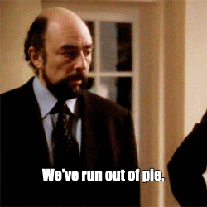
Project Requirements: AutoLab
Submit to AutoLab before the deadline
One submitter per team (can submit as many times as you like)
Unless otherwise specified, submission will always be a text file with your code’s predictions on a test dataset
If your submission is correctly formatted, your performance should show up on the leaderboard in short order
AutoLab submission shuts down after the deadline

Slide 21
Project Requirements: Lightning Talks
Wednesdays after a project deadline, all teams will give a lightning talk (~5 minutes long)
Talks will outline the problem, the team’s approach, their results, and any other discussion points
Creativity welcome—code examples, live demos, interactive slides, etc
One person from each team will speak

Slide 22

Project Grading

Slide 23
Project Grading
COVID-19 sucks
Peer evaluation: each team is assigned another team to evaluate their work
Evaluation split into three categories
Theory (the approach you use as implemented by the code)
Engineering (everything around the implementation)
“Extras”
Go above and beyond—extra points
Note shortcomings (approach is flawed or too simple, code poorly documented, one person did almost all of the project, poor performance), as well as strengths (innovative approach—even if it did not work—good division of labor, unit testing, easy to understand code, good use of tickets and milestones)
Evaluation reports will be issued to each team between projects

Slide 24
Project Grading
In all seriousness, if you
Work with your teammates (don’t ghost them)
Be a good classmate (answer other questions in Discord, come to occasional office hours / lecture, generally interact)
Conduct yourself as a decent human being
You get an A this semester
I want you all to have a little fun this semester without worrying about grades

Slide 25
Final Project
Have done this in previous years
Not doing it this semester

Slide 26
Part IV: The Next Step
CSCI 8360 Data Science Practicum

Slide 27

Project $α$
Join the Discord server (as of writing this lecture, 13 of 20 have already joined)
Send me your GitHub username over Discord (create an account if you don’t have one). Join the GitHub “Data Science Practicum” team.
Start looking at Apache Spark and/or dask (for Project 0 tomorrow).

Slide 28
Tomorrow: Project 0
The only individual project of the semester
Mainly to familiarize you with Apache Spark or dask (used for Project 1), AutoLab, GitHub, and Discord

Slide 29
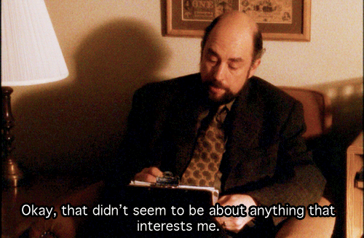
Questions?

Slide 30
Finally…
Your idea could be featured as a full project!
What large-scale problems do you want to work on?
Yes, this an opportunity to suggest Projects. If you have an idea, send me:
The problem to be solved (optimization, dimensionality reduction, classification, etc)
How the solutions should be evaluated
Training and validation datasets

Slide 31
